Slide 1
Selected topics 1
Python
Dr: Nashwa Nageh

Slide 2
Agenda
Control Structures and Repetition Structures
Introduction to repetition Structures
The for loop
The while loop
Input Validation loops
Break and Continue statements
Nested loops

Slide 3
Repetition
On many occasions, programmers need to perform certain tasks repeatedly. It can be tedious to perform such tasks in a sequential way.
It would be much easier if the programmer completes such tasks using loop instructions. Almost all programming languages facilitate the use of control loop statements to repeatedly execute a block of code until a certain condition is satisfied.
In this lecture, we will look at two broad categories of loops:
count-controlled
condition-controlled
A count-controlled loop repeats a specific number of times.
A condition-controlled loop uses a true/false condition to control the
number of times that it repeats.
In Python, you use the for statement to write a count-controlled loop, and you use the while statement to write a condition-controlled loop.

Slide 4


The For Loop
As we have said, a count-controlled loop iterates a specific number of times.
In Python, we use the for statement to write a count-controlled loop.
A for loop is used for iterating over a sequence (a string, a list, a tuple, a range object, etc..), and execute a set of statements, once for each item in a sequence.
The structure of a for loop is as follows:
for <variable name> in <sequence>:
statements to be repeated
Example 1:
The following program will print the characters of the string:
for i in "Stars":
print(i)
The following program will print Hello, along with the value of i, 5 times:
for i in range(5): #(range will be explained in the next slides)
print('Hello’, i)
OUTPUT
OUTPUT

Slide 5
Using the range Function with the for Loop
To loop through a set of code a specified number of times, we can use the range() function.
The range() function returns a sequence of numbers, starting from 0 by default, and increments by 1 (by default), and ends at a specified number.
Syntax:
range(start, stop, step)
Parameter | Description
start | Optional. An integer number specifying at which position to start. Default is 0
stop | Required. An integer number specifying at which position to stop.
step | Optional. An integer number specifying the incrementation. Default is 1
The values we put in the range function determines how many times we will loop.
The range function produces a list of numbers from zero (by default, unless other is
specified) to the value minus one.

Slide 6
Using the range Function with the for Loop
Here is an example of a for loop that uses the range function:
for num in range(5):
print(num)
Notice instead of using a list of values, we call to the range function passing 5 as an argument. In this statement, the range function will generate an iterable sequence of integers in the range of 0 up to (but not including) 5.
This code works the same as the following:
for num in [0, 1, 2, 3, 4]:
print(num)

Slide 7

The range function
0
1
2
3
.
.
.
.
.
.
.
.
99
Prints the numbers from 0 to 99.
OUTPUT

Slide 8
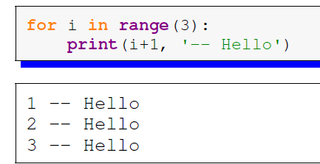
The range function
Example
Since the loop variable i, gets increased by 1 each time through the loop, it can be used to keep track of where we are in the looping process. Consider the example below:
OUTPUT

Slide 9
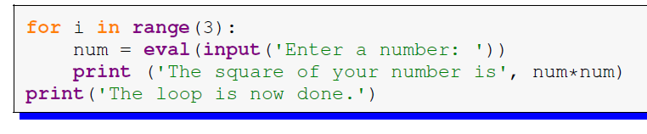
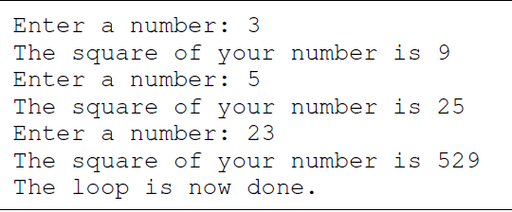
For Loop
Example 2 The program below asks the user for a number and prints its square. It does this three times and then prints: ‘The loop is done’.
The output:
No indentation here; so, it is outside the loop

Slide 10
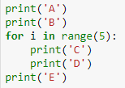
For Loop
Example 3 The program below will print A, then B, then it will C’s and D’s five times and then finish with the letter E once.
A
B
C
D
C
D
C
D
C
D
C
D
E
OUTPUT

Slide 11
More about the range function
If we want the list of values to start at a value other than 0, we can do that by specifying the starting value.
range(1,5) will produce the list 1, 2, 3, 4.
Another thing we can do is to get the list of values to go up by more than one at a time. To do this, we can specify an optional step as the third argument.
range(1,10,2) steps through the list by twos, producing 1, 3, 5, 7, 9.
To get the list of values to go backwards, we can use a step of -1
range(5,1,-1) will produce the values 5, 4, 3, 2
Note that the range function stops one short of the ending value.

Slide 12
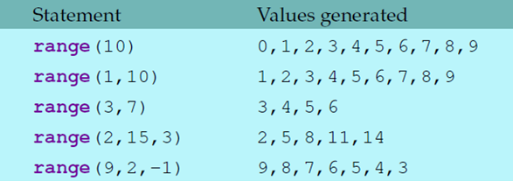
The range function
Here are a few more examples:

Slide 13
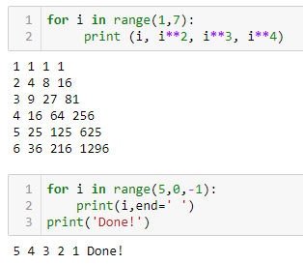
The range function
Examples:
for i in range(1,7):
print (i, i**2, i**3, i**4)
for i in range(5,0,-1):
print(i,end=‘ ')
print('Done!')

Slide 14

The range function
Example: The below codes show 2 different ways to print a string in reverse. One is done using slicing and the other is done using the range function.
Using Slicing
Using range
OUTPUT
text = "Hello World"
revText= text[::-1]
print(revText)
text= "Hello World"
for i in range(len(text)-1,-1,-1):
print(text[i],end="")
dlroW olleH
Recall that in Slicing, by leaving out start, the range will start at the first character. By leaving out the stop, the range will go to the end.

Slide 15
The range function
Example:
Write a program that prompts the user to enter 10 positive numbers, finds and prints the largest number entered by the user, using only one for loop.
N.B: Assume that the user will input only non-negative numbers.
Solution:
Sample output:
Enter 10 positive numbers:
12
2
3
4
22
0
4
6
7
6
The largest number is: 22
print('Enter 10 positive numbers: ')
largest = -1000
for i in range(10):
num = int(input())
if num>largest:
largest = num
print('The largest number is: ',largest)

Slide 16
The while Loop
We have already learned about for loops, which allow us to repeat things a specified number of times.
Sometimes, though, we need to repeat something, but we don’t know ahead of time exactly how many times it must be repeated. This introduces the need of using the condition-controlled loop.
A condition-controlled loop causes a statement or set of statements to repeat as long as a condition is true.
In Python, you use the while statement to write a condition-controlled loop.

Slide 17
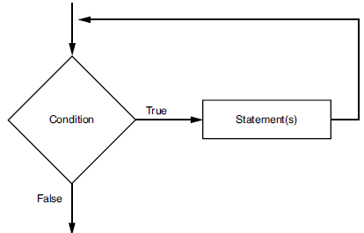
The while Loop
Here is the general format of the while loop in Python:
while condition:
block
The while loop gets its name from the way it works:
while a condition is true, do some task.
The loop iterates while the condition evaluates to true; when the condition becomes false the loop terminates.
The loop has two parts:
(1) a condition that is tested for a true or false value, and
(2) a block (statement or set of statements) that is repeated if the condition is true.
The below Figure shows the logic of a while loop.

Slide 18
The while loop
while condition:
block
The while clause begins with the word while, followed by a Boolean condition that will be evaluated as either true or false. A colon appears after the condition.
Beginning at the next line is an indented block of statements.
When the while loop executes, the condition is tested.
If the condition is true, the statements that appear in the block following the while clause are executed, and the loop starts over.
If the condition is false, the program exits the loop.

Slide 19
The while loop
while condition:
block
OUTPUT
Example:
x = 1
while x < 4: # as long as x < 4...
print (x**2) # print the square of x
x = x+1 # increment x by +1
1
4
9
Note that only the squares of 1, 2, and 3 are printed, because once x = 4, the condition is false, and the loop is terminated

Slide 20
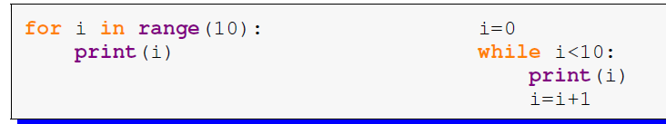
The while loop
The following while and for loops are equivalent
They have the exact same effect:
0
1
2
3
4
5
6
7
8
9
OUTPUT

Slide 21
The while loop
Input Validation
Input validation is the process of inspecting data that has been input to a program, to make sure it is valid before it is used in a computation.
Input validation is commonly done with a loop that iterates as long as an input variable references bad data.
# loop will repeat itself as long as the entered value is invalid
grade=eval(input("Enter the grade (between 0 & 20 included) "))
while grade<0 or grade>20:
print('Wrong entry!')
grade=eval(input("Enter the grade (between 0 & 20 included) "))
fgrade=grade*5
print("The grade out of hundred is",fgrade )
print("Thank you!")
Enter the grade (between 0 & 20 included) #21
Wrong entry!
Enter the grade (between 0 & 20 included) # 14
The grade out of hundred is 70
Thank you!
OUTPUT

Slide 22
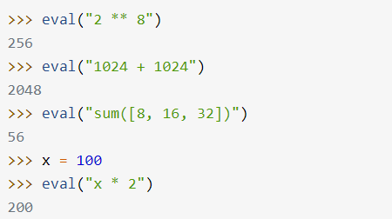
eval() function
The eval() function evaluates the specified expression, if the expression is a legal Python statement, it will be executed.
To evaluate a string-based expression, Python’s eval() runs the following steps:
Analyze expression
Compile it to bytecode
Evaluate it as a Python expression
Return the result of the evaluation

Slide 23
The while loop
Pitfall to avoid:
while statements are intended to be used with changing conditions.
If the condition in a while statement does not change, the program will be in an indefinite loop until the user hits ctrl-c.
Indefinite loops usually occur when the programmer forgets to write code inside the loop that makes the test condition false.
Example:
x = 1
while x == 1:
print('Hello world‘)
# Indefinite loop! Python will keep printing
# “Hello world” because x does not change!

Slide 24
The while loop
The optional else clause runs only if the loop exits normally (not by break)
OUTPUT
x = 1
while x < 3 :
print (x)
x = x + 1
else:
print (‘The loop ended normally')
1
2
The loop ended normally

Slide 25
The while Loop
Example:
Write a program that reads the grades of several students in a class and calculates the grade-point average for that class. The number of students is unknown, and the program should stop when the user enters any negative number.
count = 0
Sum = 0
grade = float(input('Enter student grade; any negative number to stop: '))
while grade >=0:
Sum += grade
count += 1
grade = float(input('Enter student grade; any negative number to stop: '))
average = Sum/count
print("The average is: ",format(average,'.2f'))
Enter student grade; any negative number to stop: 15
Enter student grade; any negative number to stop: 12
Enter student grade; any negative number to stop: 16
Enter student grade; any negative number to stop: 0
Enter student grade; any negative number to stop: 5
Enter student grade; any negative number to stop: -15
The average is: 9.60
OUTPUT

Slide 26
The break statement
With the break statement we can stop the loop even if the while condition is true:
Condition ?
Loop
False
break causes a jump outside the loop
True
Statement 1
break

Slide 27
The break Statement
Now, consider this program with break
x = 1
while x < 5 :
print (x)
x = x + 1
break
else :
print (The loop ended normally')
print("Done!")
OUTPUT
1
Done!

Slide 28
The continue Statement
With the continue statement, we can stop the current iteration and continue with the next.
Condition ?
continue bypasses the remaining and continues with the next iteration
Loop
False
True
Statement 1
Statements ignored or skipped
continue
Statement n

Slide 29
The continue Statement
Now, consider this program with continue
x = 0
while x < 5 :
x+=1
if x==3:
continue
print(x)
else :
print ('The loop ended normally')
print("Done!")
1
2
4
5
The loop ended normally
Done!
OUTPUT
Notice how the number 3 hasn’t been printed!

Slide 30
Comparison between break and continue
break | continue
It terminates the execution of remaining iteration of the loop. | It terminates only the current iteration of the loop.
'break' resumes the control of the program to the end of loop enclosing that 'break'. | 'continue' resumes the control of the program to the next iteration of that loop enclosing 'continue'.
It causes early termination of loop. | It causes early execution of the next iteration.
'break' stops the continuation of loop. | 'continue’ does not stop the continuation of loop, it only stops the current iteration.

Slide 31
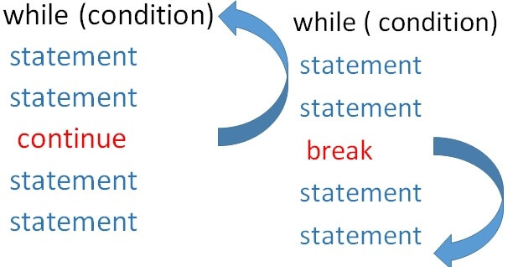
Comparison between break and continue

Slide 32
Comparison between break and continue
Example:
Exit the loop when i is 3:
break
Continue to the next iteration if i is 3:
continue
i = 0 while i < 6: i += 1 if i == 3: break print(i)
i = 0 while i < 6: i += 1 if i == 3: continue print(i)
1 2 4 5 6
OUTPUT
1 2
OUTPUT

Slide 33
Nested loops
A nested loop is an inner loop in the loop body of the outer loop. The inner or outer loop can be any type, such as a while loop or for loop. For example, the outer for loop can contain a while loop and vice versa.
The outer loop can contain more than one inner loop. There is no limitation on the chaining of loops.
In the nested loop, the number of iterations will be equal to the number of iterations in the outer loop multiplied by the iterations in the inner loop.
In each iteration of the outer loop inner loop execute all its iteration.
For each iteration of an outer loop the inner loop re-start and completes its execution before the outer loop can continue to its next iteration.

Slide 34
Nested loops
Nested for Loop
In Python, the for loop is used to iterate over a sequence.
Syntax of using a nested for loop in Python
# outer for loop
for element in sequence:
# inner for loop
for element in sequence:
body of inner for loop
body of outer for loop

Slide 35
Nested loops
Example:
for i in range (2): for j in range (3): print(i," ",j)
Outer loop
Inner loop
OUTPUT
0 0
0 1
0 2
1 0
1 1
1 2
Number from outer loop
Number from inner loop

Slide 36
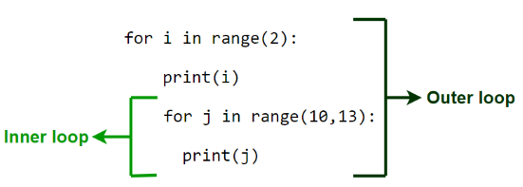
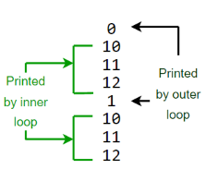
Nested loops
Example:
OUTPUT

Slide 37
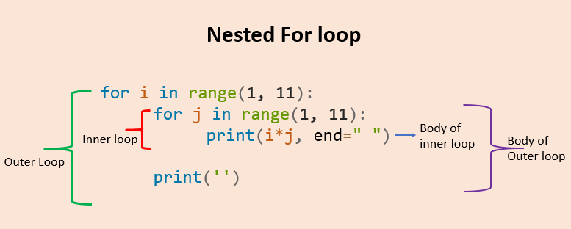
Nested loops
Nested for Loop- Example
1 2 3 4 5 6 7 8 9 10
2 4 6 8 10 12 14 16 18 20
3 6 9 12 15 18 21 24 27 30
4 8 12 16 20 24 28 32 36 40
5 10 15 20 25 30 35 40 45 50
6 12 18 24 30 36 42 48 54 60
7 14 21 28 35 42 49 56 63 70
8 16 24 32 40 48 56 64 72 80
9 18 27 36 45 54 63 72 81 90
10 20 30 40 50 60 70 80 90 100
for i in range(1,11):
for j in range(1,11):
print(i*j, end=" ")
print('')

Slide 38
Nested loops
Nested while Loop
In Python, the while loop can be used to iterate over a sequence as well.
Syntax of using a nested while loop in Python
# outer while loop
while expression:
# inner while loop
while expression:
body of inner while loop
body of outer while loop

Slide 39
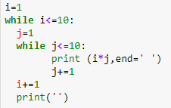
Nested loops
Nested while Loop- Example
1 2 3 4 5 6 7 8 9 10
2 4 6 8 10 12 14 16 18 20
3 6 9 12 15 18 21 24 27 30
4 8 12 16 20 24 28 32 36 40
5 10 15 20 25 30 35 40 45 50
6 12 18 24 30 36 42 48 54 60
7 14 21 28 35 42 49 56 63 70
8 16 24 32 40 48 56 64 72 80
9 18 27 36 45 54 63 72 81 90
10 20 30 40 50 60 70 80 90 100
i=1
while i<=10:
j=1
while j<=10:
print (i*j, end=' ')
j+=1
i+=1
print('')
OUTPUT
Try to enhance the layout of the output!
Outer loop
Inner loop
Body of Outer loop
Body of inner loop

Slide 40
Exercise 1
The distance a vehicle travels can be calculated as follows:
distance = speed * time
For example, if a train travels 40 miles per hour for three hours, the distance traveled is 120 miles.
Write a program that asks the user for the speed of a vehicle (in miles per hour)
and the number of hours it has traveled. It should then use a loop to display the distance the vehicle has traveled for each hour of that time period.
Here is an example of the desired output:
What is the speed of the vehicle in mph? 40 Enter
How many hours has it traveled? 3 Enter
Hour Distance Traveled
------------------------------------
1 40
2 80
3 120

Slide 41
Exercise 1- Solution
# Declare variables for the distance, speed, and time.
distance = 0
speed = 0.0
time = 0
# Get the speed as input from the user.
speed = float(input('Enter the speed of the vehicle in mph: '))
# Get time traveled and convert to integer for full hours.
time = int(float(input('Enter the number of hours traveled: ')))
# Display the distance traveled by hour.
print ('Hour\tDistance Traveled')
print ('------------------------')
for hour in range(1, time + 1):
distance = hour * speed
print (hour, '\t',distance)

Slide 42
Exercise 2
2. Write a program that predicts the approximate size of a population of organisms. The application should use text boxes to allow the user to enter the starting number of organisms, the average daily population increase (as a percentage), and the number of days the organisms will be left to multiply.
For example, assume the user enters the following values:
Starting number of organisms: 2
Average daily increase: 30
Number of days to multiply: 10
The program should display the following table of data:
Day Approximate Population
1 2
2 2.6
3 3.38
4 4.394
5 5.7122
6 7.42586
7 9.653619
8 12.5497
9 16.31462
10 21.209

Slide 43
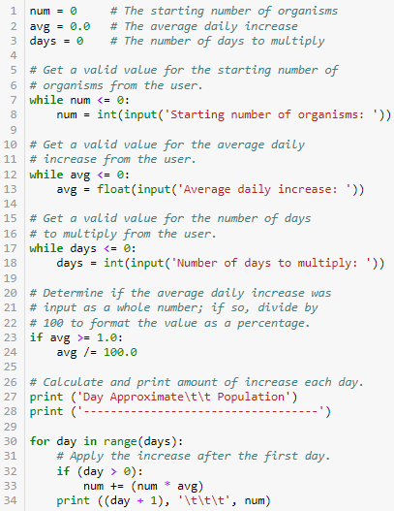
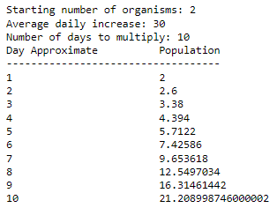
Exercise 2- Solution

Slide 44
Exercise 3
3. Running on a particular treadmill you burn 4.2 calories per minute.
Write a program that uses a loop to display the number of calories burned after 10, 15, 20, 25, and 30 minutes.
# Declare and initialize a variable
# for the calories burned per minute.
caloriesPerMinute = 4.2
# Declare variables for the number of calories burned,
# and the number of minutes.
caloriesBurned = 0.0
minutes = 0
print ('Minutes\t\tCalories Burned')
print ('-------------------------------')
# Execute the for loop to display calories burned.
for minutes in range(10, 31, 5):
caloriesBurned = caloriesPerMinute * minutes
print (minutes, "\t\t", caloriesBurned)
Solution

Slide 45
Exercise 4
4. At one college, the tuition for a full-time student is $8,000 per semester.
It has been announced that the tuition will increase by 3 percent each year for the next 5 years.
Write a program with a loop that displays the projected semester tuition amount for the next 5 years.
# Constants for the increase in tuition per year,
# and the starting tuition amount.
INCREASE_PER_YEAR = 0.03
STARTING_AMOUNT = 8000.0
# Declare a variable to store the tuition.
tuition = STARTING_AMOUNT
# Calculate and print amount of increase each year.
print ('Year\t Projected Tuition (per Semester)')
print ('------------------------------------------')
for year in range(5):
tuition += (tuition * INCREASE_PER_YEAR)
print ((year + 1), '\t', '$', \
format(tuition, '.2f'))
Year Projected Tuition (per Semester)
-------------------------------------------------------------
1 $ 8240.00
2 $ 8487.20
3 $ 8741.82
4 $ 9004.07
5 $ 9274.19
Solution

Slide 46
Extra Exercises
Find the output of the following code:
for i in range (3): for j in range (5): print("*",end=" ") print() | for i in range (5): for j in range (i): print("*",end=" ") print()
for i in range (4): for j in range (3): print(i+j,end=" ") print() | for i in range (5): for j in range (i+1): print("*",end=" ") print()

Slide 47
Extra Exercises
Write a program that prints the multiplication table for 6 as follows:
1 x 6 = 6
2 x 6 = 12
3 x 6 = 18
…
10 x 6 = 60
Write a program that prints all odd numbers from 1 to 100.
Write a program that prompts the user to enter 10 positive numbers, finds and prints the smallest number entered by the user.
Write a program that prompts the user to enter 10 numbers, counts and prints the number of positive numbers, negative numbers are zeros entered by the user.
Write a program that prompts the user to enter positive integers (0 to stop). The program should count and print the maximum integer and the minimum integer entered by the user.
Write a program that prompts the user to enter positive integers (0 to stop). The program then should count and print the number of odd integers and even integers entered by the user.

Slide 48
Extra Exercises
Write a program that reads from the user a sentence. The program should count the number of occurrences of the character ‘a’ in the sentence.
Write a program that reads from the user 10 words. The program then should count and print the number of words that start with character ‘a’.
Write a program that reads words (“finish” to stop). The program then should count and print the number of words that start with character ‘a’.
Write a program that reads from the user 10 words. The program then should find and print the longest word.
Write a program that reads from the user 10 words. The program then should find and print the shortest word.

